Slide 1
Full Stack Development Project Demo
Anti Brutus - A Password Manager
Third Year, Semester 5, B. Tech Cybersecurity and Forensics
By: Group 8
Roll Numbers: 7, 10, 24, 25

Slide 2
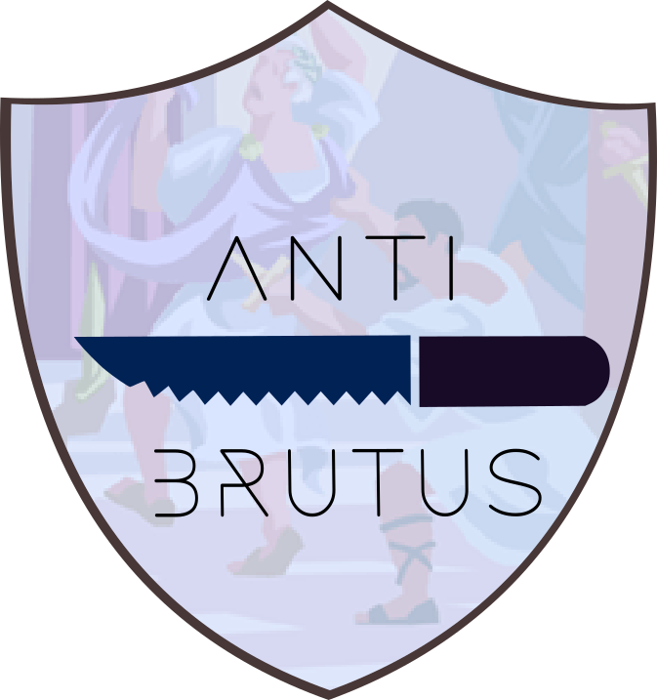
Introduction
Anti Brutus uses a combination of the latest in Cyber Security techniques and the most advanced encryption algorithms to protect your data. We use a combination of Salting, Hashing with SHA-256 and Secure SQL Databases with fortified backend servers to ensure that your data is safe from any third-party. We also use a combination of the latest in authentication techniques to ensure that only you can access your data.

Slide 3
Usage
It's already difficult remembering all your passwords, and with more and more websites that require login, it is becoming increasingly difficult to remember all your passwords. This is where Anti Brutus comes in.
Anti Brutus is a password manager that allows you to store all your passwords in one place, and access them with a Single Master Password. This way, you only need to remember one password, and you can access all your passwords from anywhere in the world.
It is however, also difficult to maintain strong passwords for each new website that you visit, for this, we offer our Password Generator which allows you to generate strong passwords for each new website that you visit, and store them in your vault.

Slide 4




Technologies Used
Frontend
React JS
Tailwind CSS
Daisy UI
Hero Icons
Tabler Icons
Backend
Node JS
Express JS
MariaDB or MySql

Slide 5
Features
Generate Passwords using Unique Hash Scheme
Store Passwords
Near Unbreakable Security
Master Password Protection
AES Encryption
Envelope Encryption
Hashing and Salting
Suited for Mobile and PC Alike, Responsive.

Slide 6
Future Prospects and Improvements
Include a KDC
Include Authentication with Biometrics, or 2 Factor Authentication App
Include login with Google or Facebook accounts.
Include a Password Strength Meter
Ability to Export Passwords in CSV, and import that csv.
Store Credit cards and other information.
Better and Enhanced Search Features
Checks for Duplicate Passwords, or Weak Passwords
Check for Breached Passwords

Slide 7
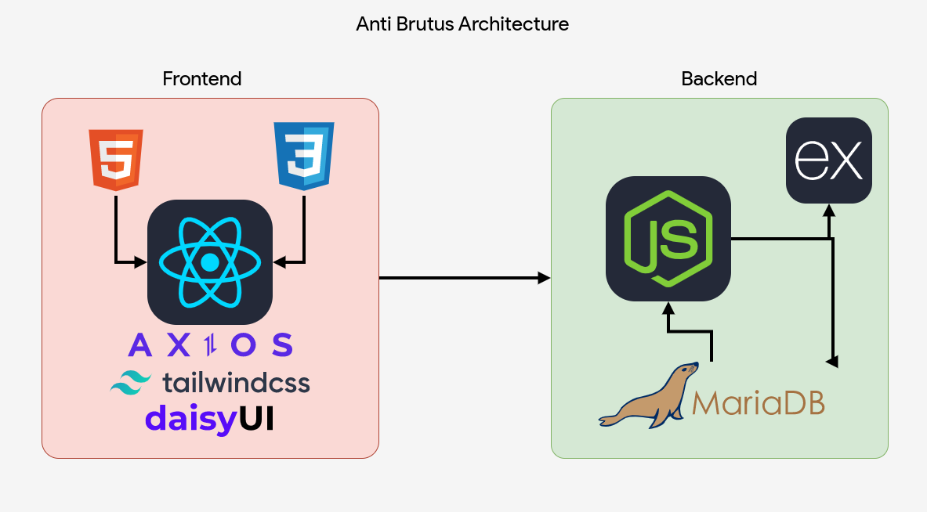
Workflow and Architecture Diagram

Slide 8
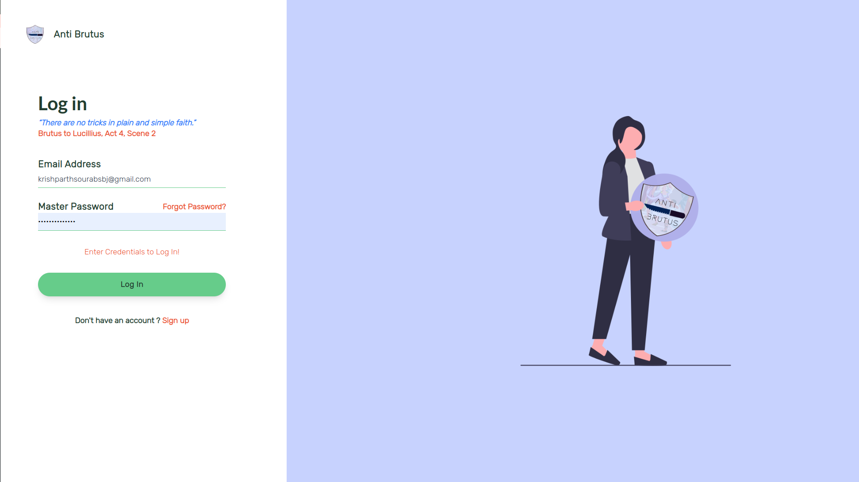
Screenshots

Slide 9
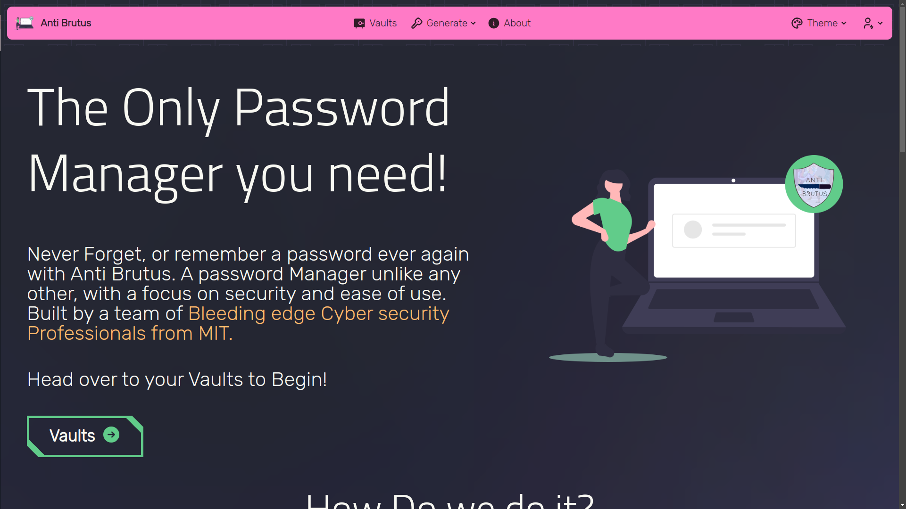

Slide 10
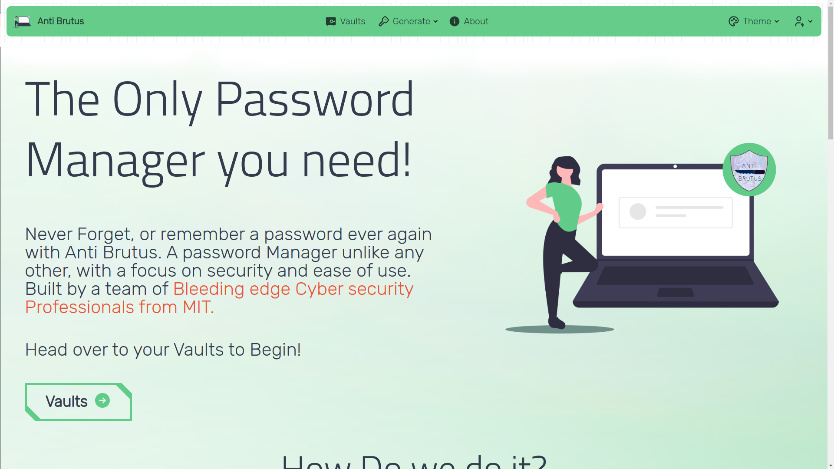

Slide 11
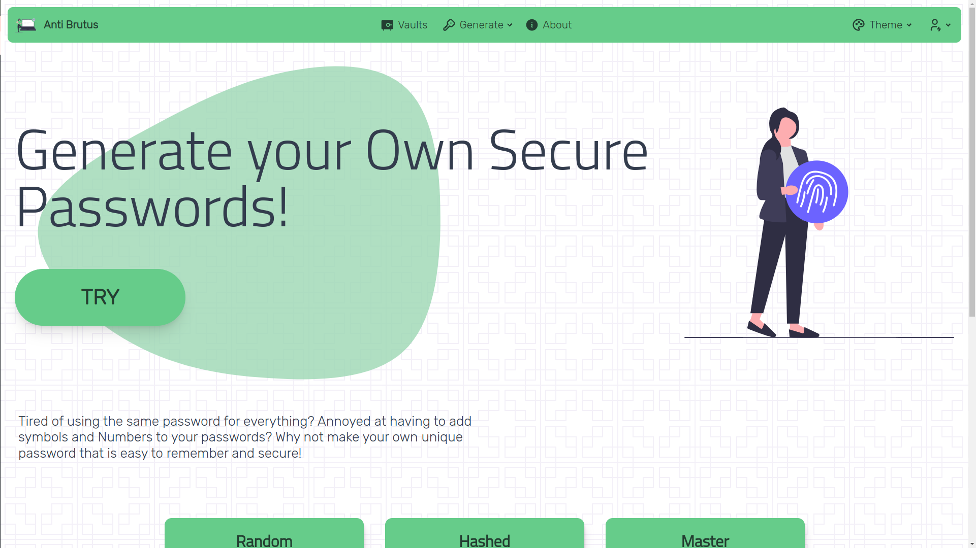

Slide 12
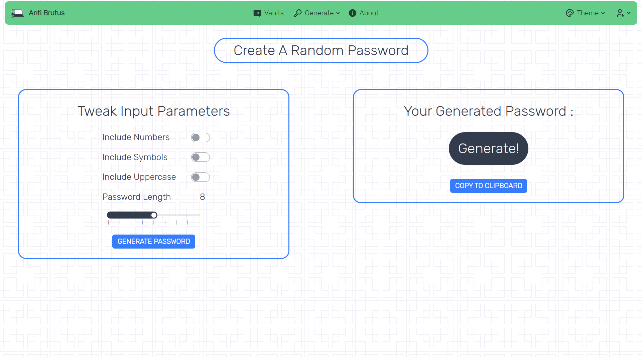

Slide 13
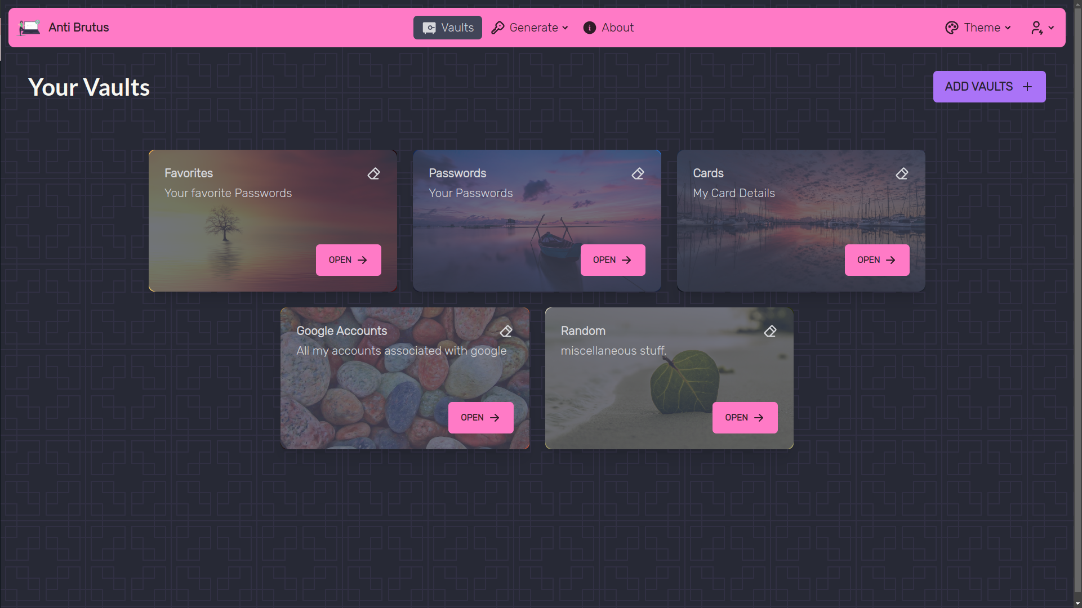

Slide 14
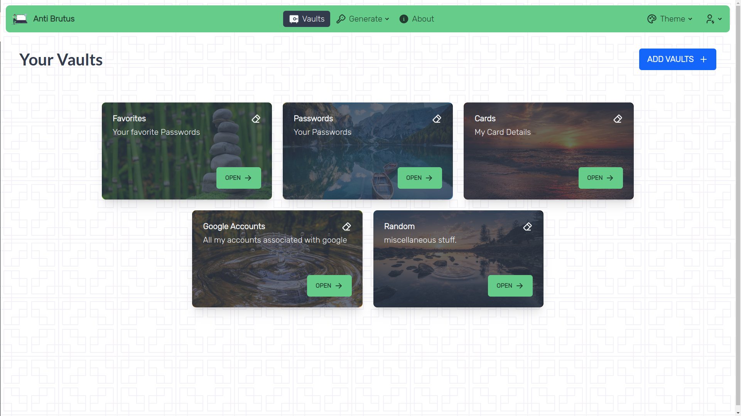

Slide 15
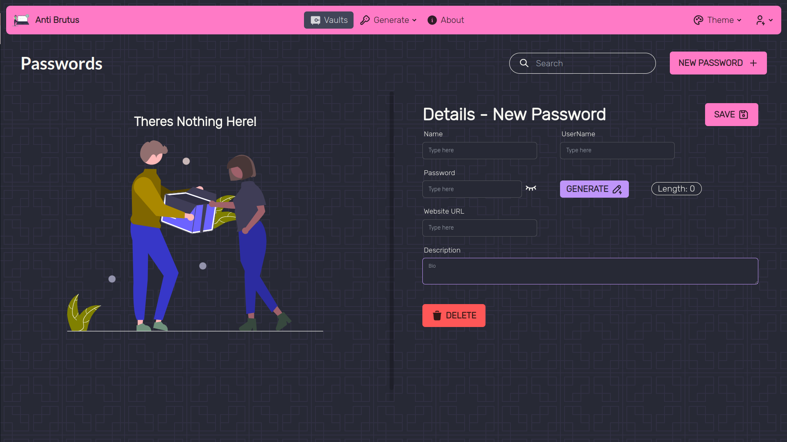

Slide 16
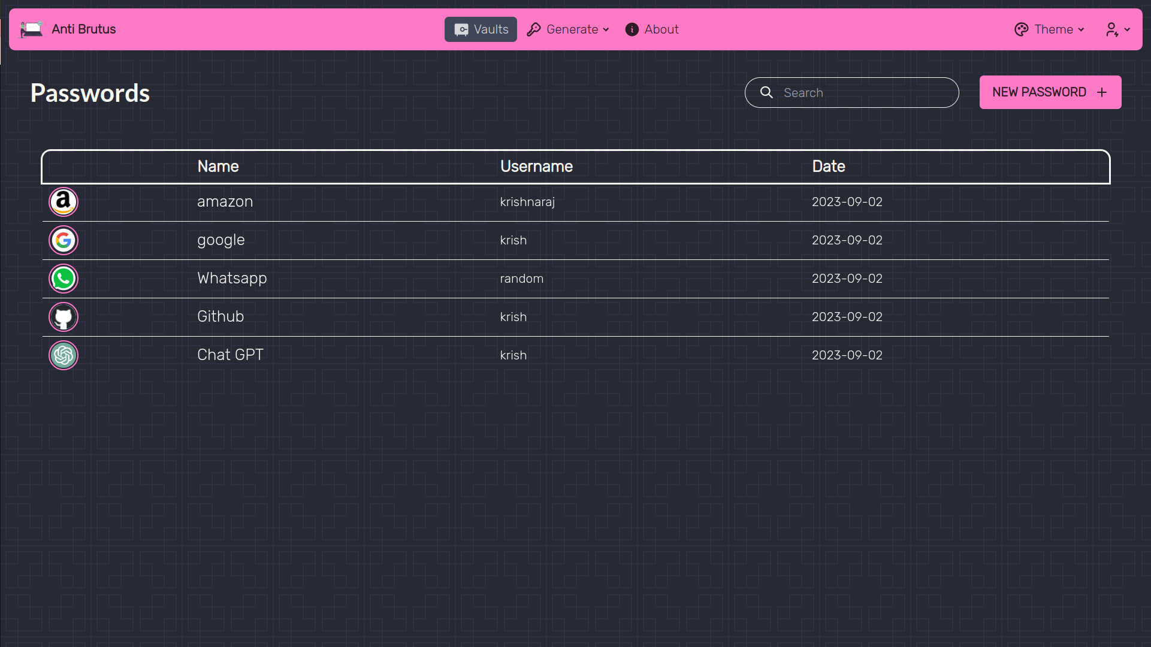

Slide 17
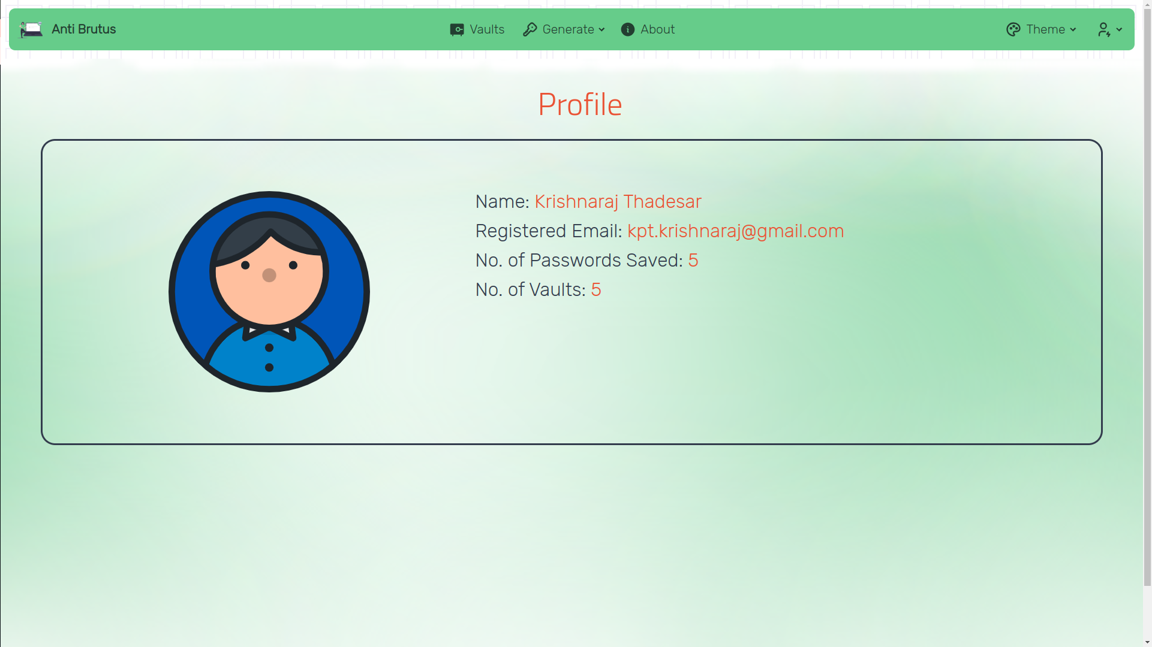

Slide 18
References
[1] DaisyUI, Tailwind CSS plugin for beautiful UI components,
https://daisyui.com/
[2] Hero Icons, A set of free MIT-licensed high-quality SVG icons for UI development,
https://heroicons.com/
[3] Tabler Icons, Over 1250 free MIT-licensed high-quality SVG icons for you to use in your web
projects,
https://tablericons.com/

Slide 19
References
[4] Tailwind CSS, A utility-first CSS framework for rapidly building custom user interfaces,
https://tailwindcss.com/
[5] ReactJS, A JavaScript library for building user interfaces,
https://reactjs.org/
[6] Bitwarden, A password Manager,
https://bitwarden.com/

Slide 20
Thank You!
Team, Anti Brutus

